Slide 1

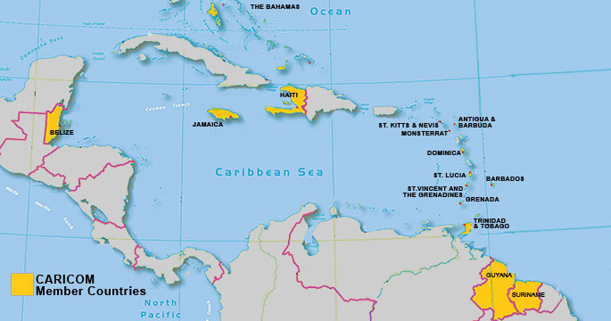
CARIBBEAN COMMUNITY (CARICOM)
Antigua & Barbuda
The Bahamas **
Barbados
Belize
Dominica
Grenada
Guyana
Haiti
Jamaica
St. Kitts and Nevis
Saint Lucia
St. Vincent and the Grenadines
Suriname
Trinidad and Tobago

Slide 2

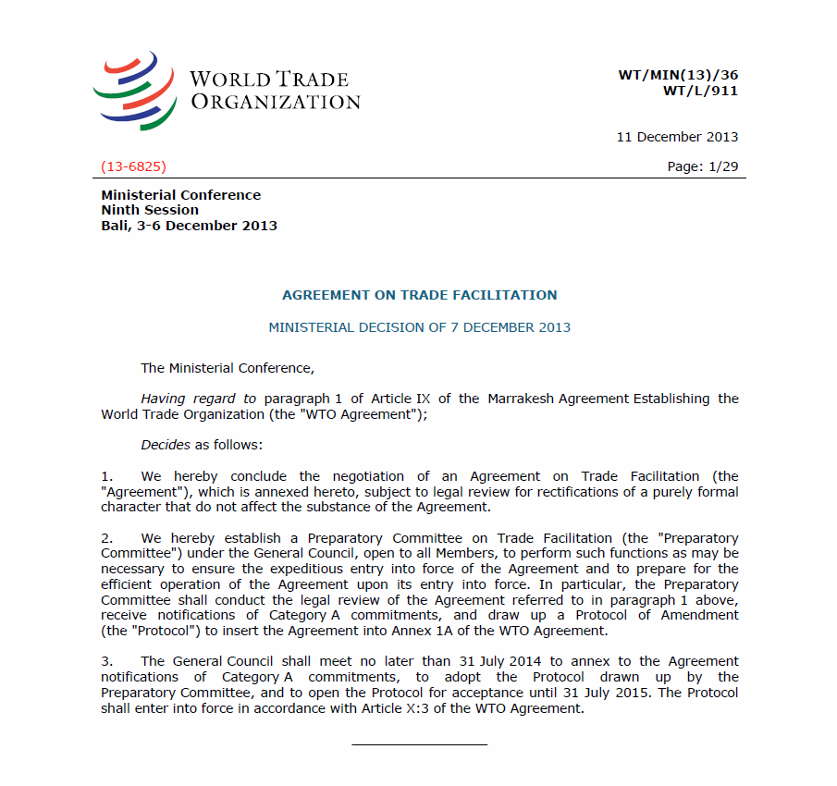
CARICOM TFA STRATEGY.
Targets (5) Priority areas for implementation
  Transparency Provisions
  Test Procedures
  Single Window
  Risk Management
  Post Clearance Audit

Slide 3
CARICOM TFA STRATEGY
Common framework for design and delivery of regional capacity building initiatives and interventions;
Tool for engaging donors and co-ordinating donor support at the regional level;
Rationalize use of scare donor resources;
Harness regional expertise for TACB support;
Public-private partnerships to design regional projects.

Slide 4
CARICOM’s EXPERIENCE:
MAIN HEADLINES……
...TFA Implementation support needs are not static!
…Identifying and engaging donors take time, and oftentimes have to be implemented on a dual track!
... Geographical eligibility and other criteria!
... Limited amount of Grant Resources!

Slide 5
Thank you for your attention
www.caricom.org

