Slide 1

Update on ratifications and notifications
WTO Secretariat
February 2020

Slide 2

Good news!

Slide 3
developing members have
100% RATE OF implementation of tfa commitments
15
9 developing Members designated all TFA provisions in Category A:
Chile, Hong Kong, China, Israel, Rep. of Korea, Mexico, Kingdom of Saudi Arabia, Singapore, Chinese Taipei, Turkey
6 developing Members are currently at 100% implementation of the TFA – provisions in B/C are now being implemented*:
Brazil, China, Georgia, Macao, China, North Macedonia, Oman
*according to notification

Slide 4
18 LDCs notified before the February 2021 deadline
18 LDC Members have notified indicative dates for their category C commitments ahead of the February 2021 deadline:
Burkina Faso, Cambodia, Central African Republic, Democratic Republic of the Congo, The Gambia, Lao People’s Democratic Republic, Lesotho, Liberia, Madagascar, Malawi, Mauritania, Mozambique, Senegal, Sierra Leone, Togo, Uganda, Vanuatu, Zambia.

Slide 5


Updates
Database
Members can now search the database for all notifications by date, type of notification and document symbol
The database has a tool that detects broken web-links in transparency notifications. A report identifying broken links can be provided to Members at their request
https://tfadatabase.org/trade-facilitation-committee
NewsBytes
Trade Facilitation NewsBytes will now be issued in all three languages

Slide 6
Ratifications

Slide 7
Four ratifications
Maldives
Guinea
Burundi
Cabo Verde

Slide 8
Implementation

Slide 9
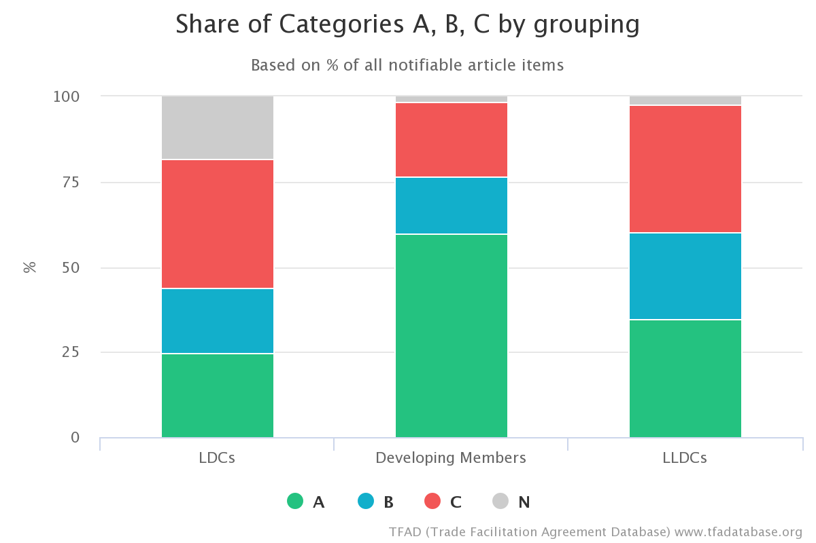
Implementation notifications
17 notifications received since the last meeting

Slide 10
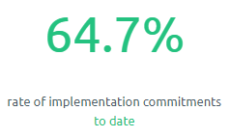
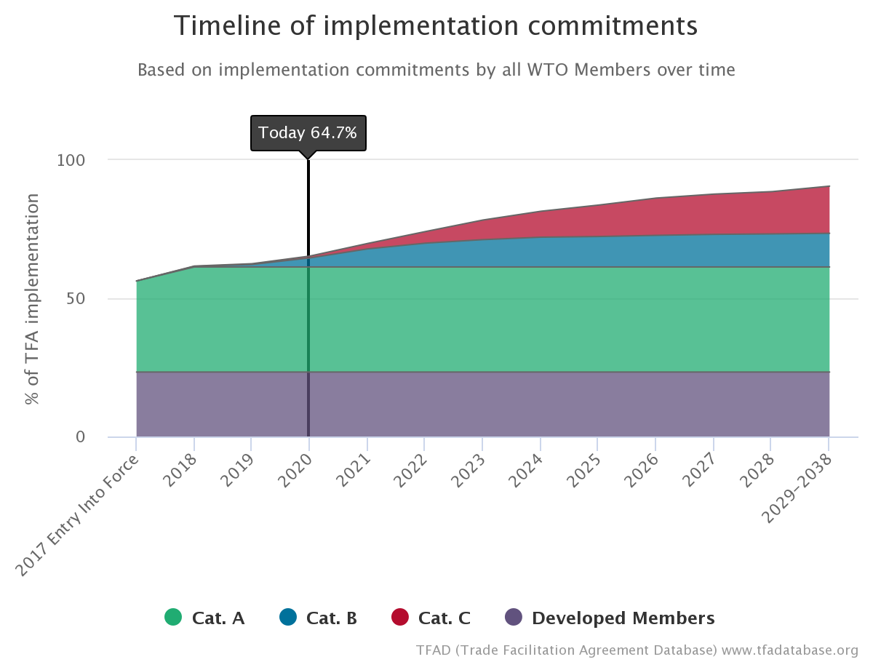
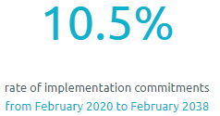
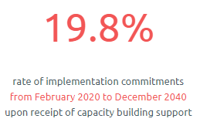
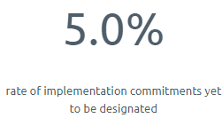

Slide 11
Transparency

Slide 12
21 notifications since the last meeting
Article 1.4
Article 10.4.3
Article 10.6.2
Article 12.2.2
8
8
16
16

Slide 13
Technical assistance and support for capacity building

Slide 14
1
Articles 22:1 + 22:2
4
Article 22:3

