Slide 1
Status of ratification and implementation

Slide 2
Contents
Ratifications
Implementation notifications
Transparency notifications
TACB information notifications

Slide 3
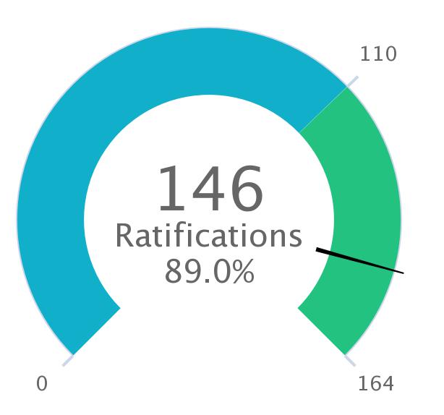
Ratifications
Tajikistan (2 July 2019)
Maldives (1 October 2019)
17 To go
Notes:
Pending notifications pertain to DCs and LDCs

Slide 4
Implementation notifications

Slide 5
Overview
Category A | Category B | Category C
118 | 96 | 86
56 notifications received from 48 Members since the last meeting
Deadlines
LDCs
Definitive B dates 22 February 2020
LDCs
Indicative C dates 22 February 2021
LDCs
Definitive C dates 22 August 2022
Notes:
56 implementation notifications were received since the last committee.

Slide 6
Category C notifications
60 developing Members have designated category C commitments to date of which 55 have presented definitive dates (92%)
Notes:
Albania, Armenia, Bolivia, Cameroon and Morocco have provided indicative but only some or none definitive dates for the implementation of category C commitments.

Slide 7
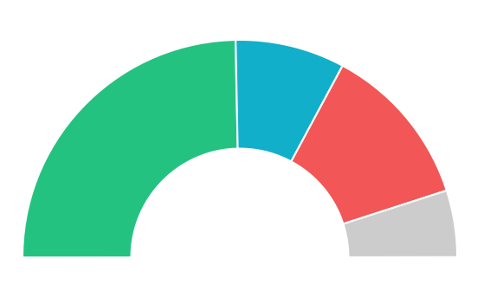
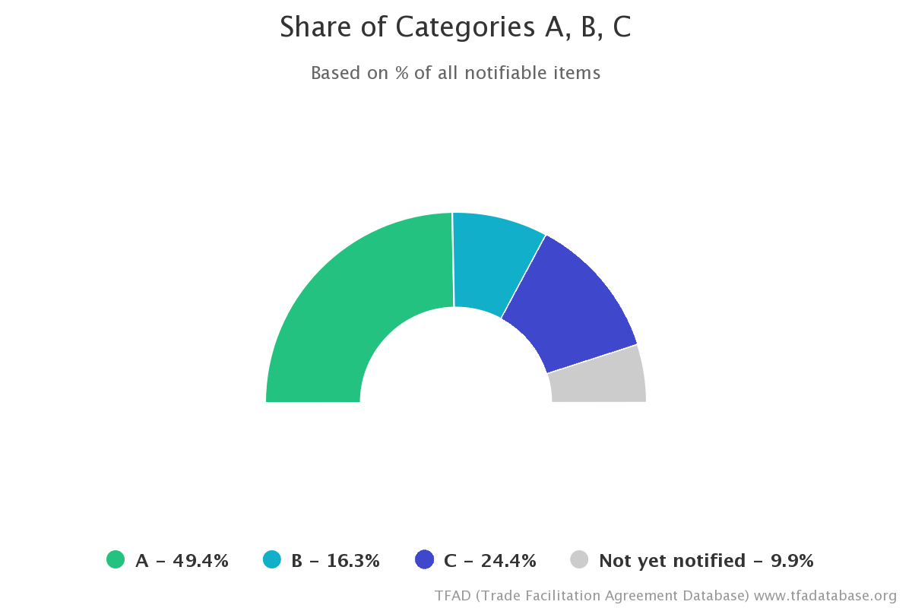

Share of categories ABC
Notes:
Percentage of “not notified” last session: 18.70%; reduced in half through an increase of B and C

Slide 8
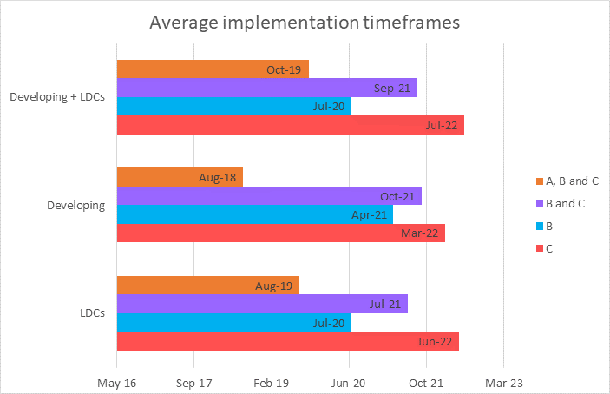

Slide 9
TACB requests
Developing countries
LDCs
Notes:
Notification dates have already lapsed
DCs: 22/08/2017
LDCs: 22/02/2019

Slide 10
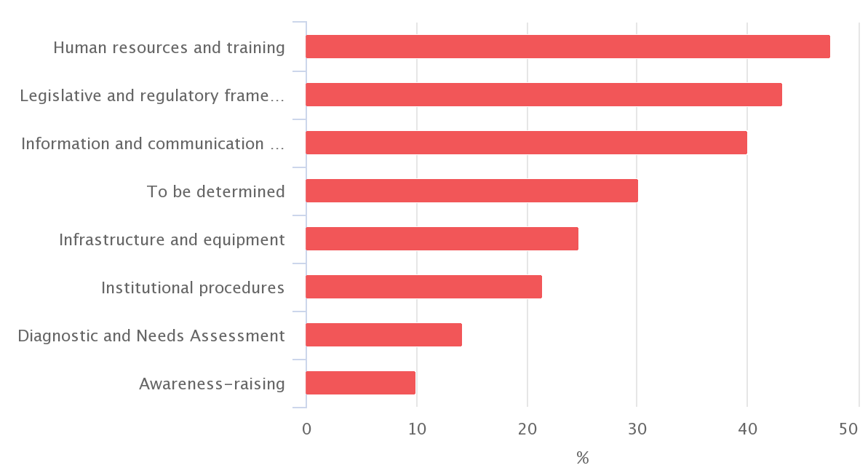
TACB Requests
Notes:
Since the last meeting, there was a reduction in the “to be determined” category, however there were no changes in the hierarchy of TACB requests.
These are related to the measures which have the lowest implementation rates (next slide)

Slide 11
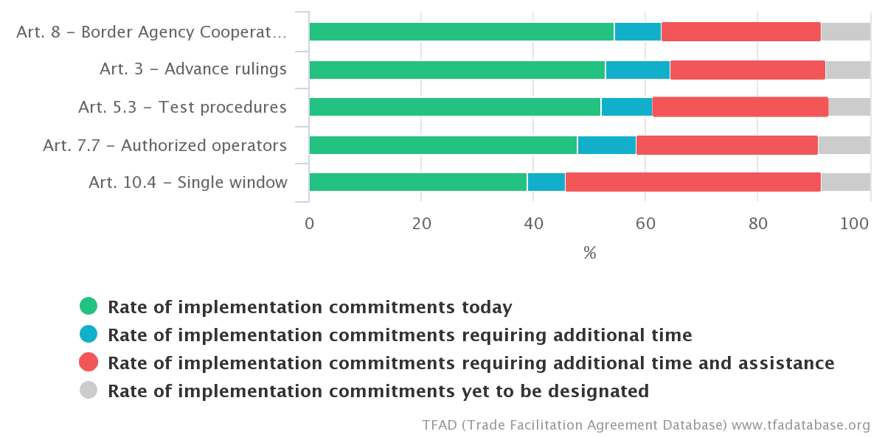
Top 5 measures with least implementation

Slide 12
Transparency notifications

Slide 13
Overview
Article 1.4
82
Article 10.4.3
67
Article 10.6.2
85
Article 12.2.2 76
Notes:
13 notifications were received since the last committee

Slide 14
Technical Assistance and Capacity Building

Slide 15
Overview
Article 22.1
16
Article 22.2
9
Article 22.3
20
Notes:
13 notifications received since the last meeting

